Slide 1

SQL Syntax
- CH.Bharath.

Slide 2
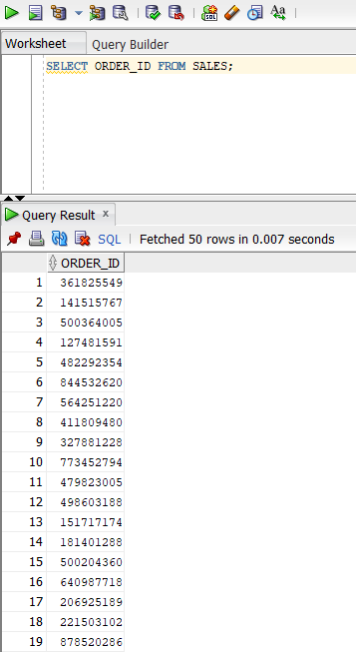
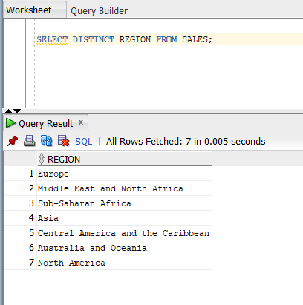
SQL DISTINCT Clause:
SELECT ORDER_ID FROM SALES
SQL DISTINCT Clause:
SELECT DISTINCT REGION FROM SALES

Slide 3
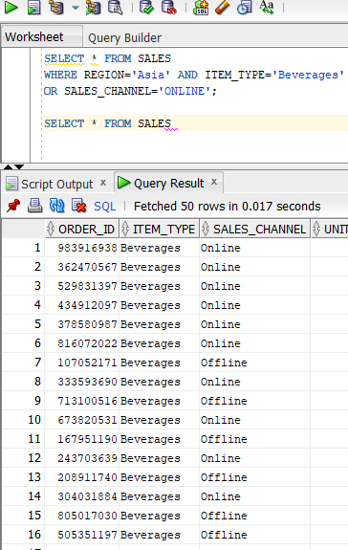
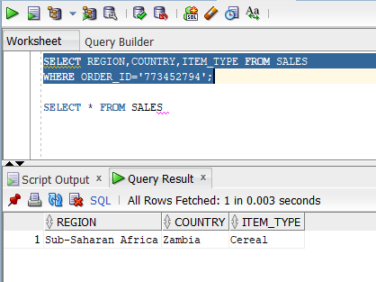
SQL AND/OR Clause:
SELECT * FROM SALES
WHERE REGION='Asia' AND ITEM_TYPE='Beverages’
OR SALES_CHANNEL='ONLINE'
SQL WHERE Clause:
SELECT REGION,COUNTRY,ITEM_TYPE FROM SALES
WHERE ORDER_ID='773452794';

Slide 4
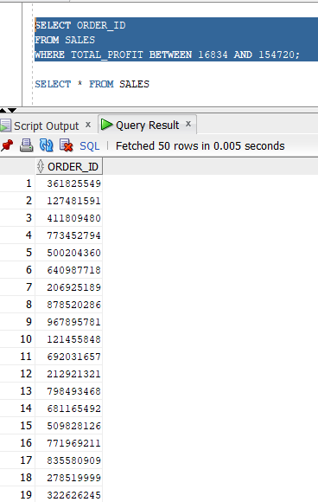
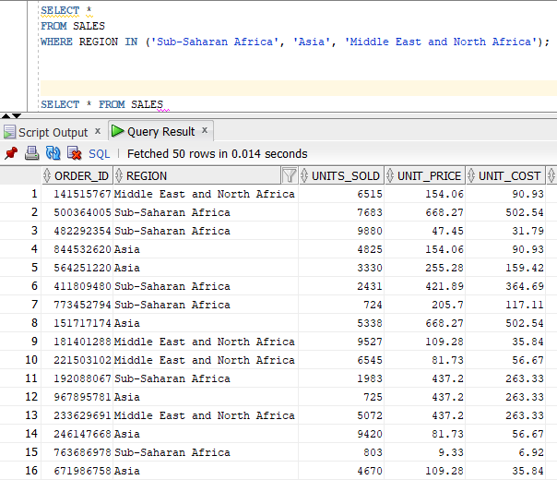
SQL IN Clause:
SELECT *
FROM SALES
WHERE REGION IN ('Sub-Saharan Africa', 'Asia', 'Middle East and North Africa');
SQL BETWEEN Clause:
SELECT ORDER_ID
FROM SALES
WHERE TOTAL_PROFIT BETWEEN 16834 AND 154720;

Slide 5
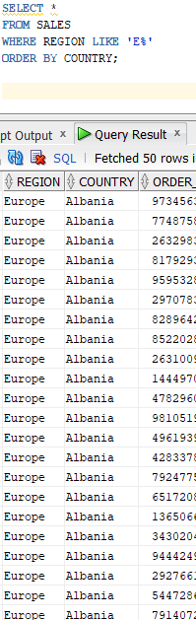
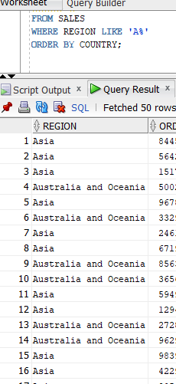
SQL LIKE Clause:
SELECT *
FROM SALES
WHERE REGION LIKE 'A%'
SQL ORDER BY Clause:
SELECT *
FROM SALES
WHERE REGION LIKE 'E%'
ORDER BY COUNTRY;

Slide 6
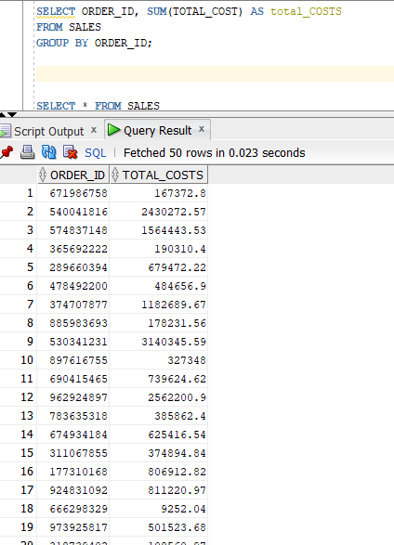
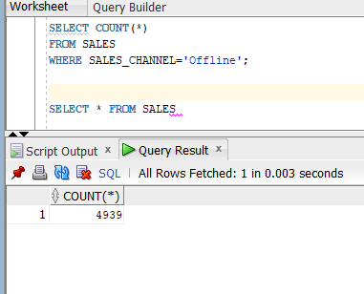
SQL GROUP BY Clause:
SELECT ORDER_ID, SUM(TOTAL_COST) AS total_COSTS
FROM SALES
GROUP BY ORDER_ID;
SQL COUNT Clause:
SELECT COUNT(*)
FROM SALES
WHERE SALES_CHANNEL='Offline';

Slide 7
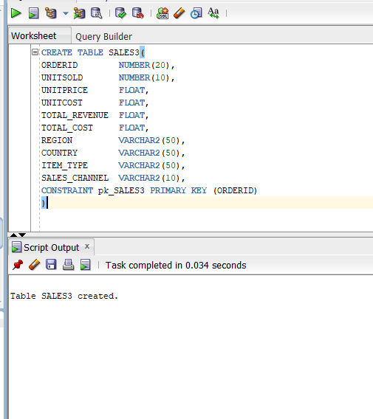
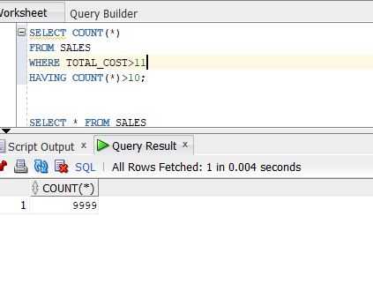
SQL HAVING Clause:
SQL CREATE TABLE Statement:
SELECT COUNT(*)
FROM SALES
WHERE TOTAL_COST>11
HAVING COUNT(*)>10;

Slide 8
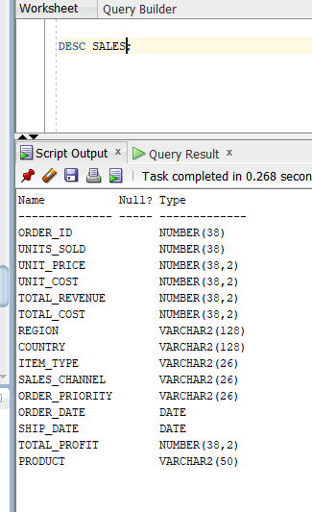
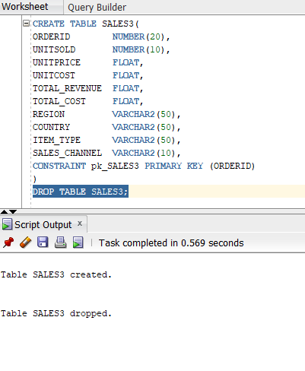
SQL DESC Statement:
DESC SALES;
SQL DROP TABLE Statement:
DROP TABLE SALES3;

Slide 9
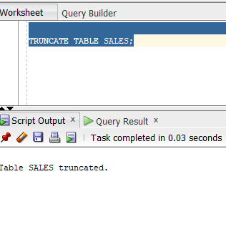
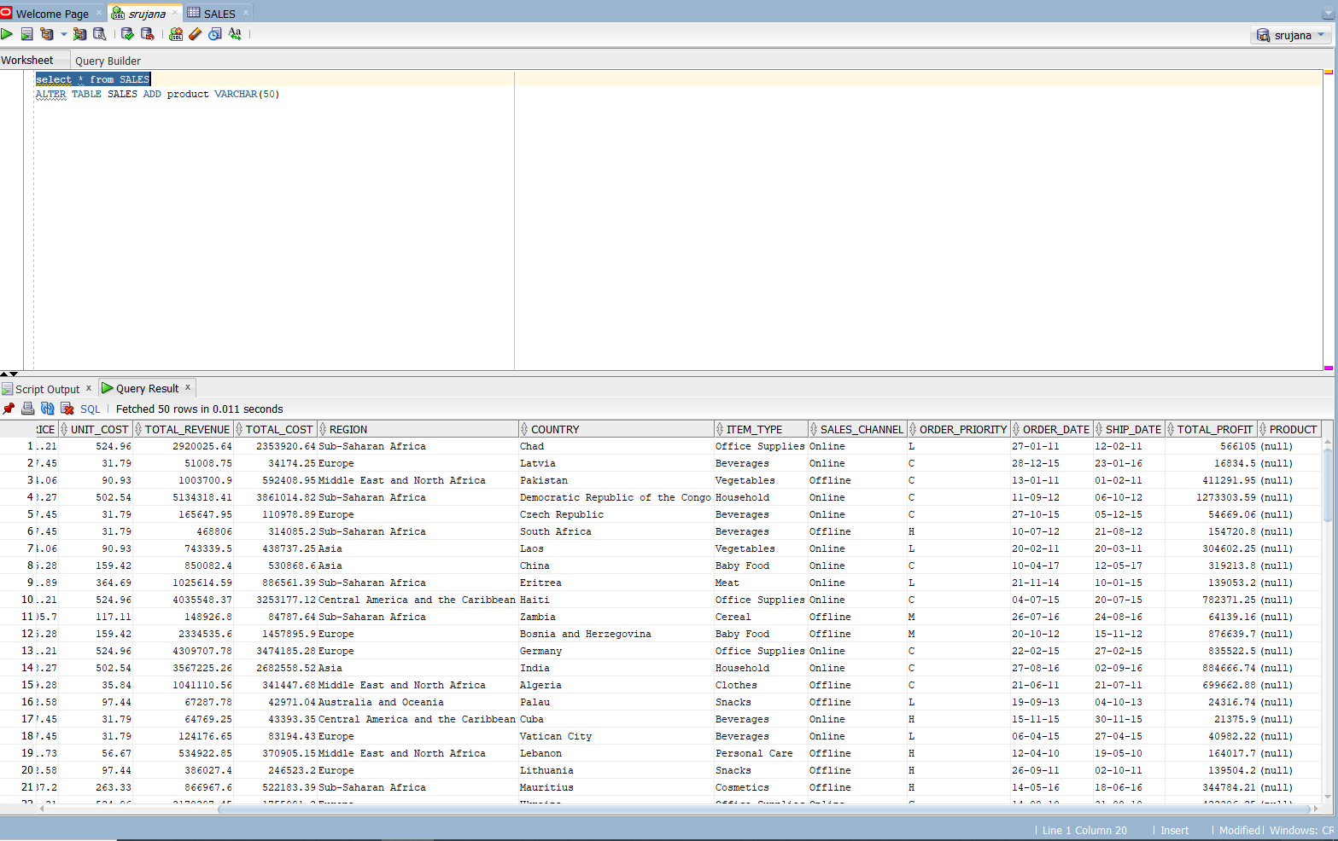
SQL TRUNCATE TABLE Statement:
TRUNCATE TABLE SALES;
SQL ALTER TABLE Statement:
ALTER TABLE SALES ADD PRODUCT VARCHAR(50)

Slide 10
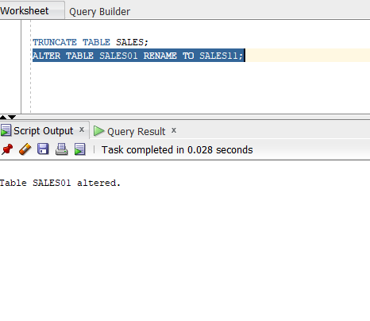
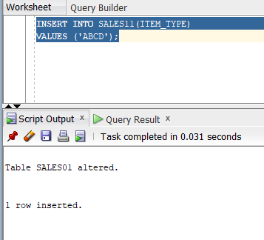
SQL ALTER TABLE Statement (Rename):
ALTER TABLE SALES01 RENAME TO SALES11;
SQL INSERT INTO Statement:
INSERT INTO SALES11(ITEM_TYPE)
VALUES ('ABCD');

Slide 11
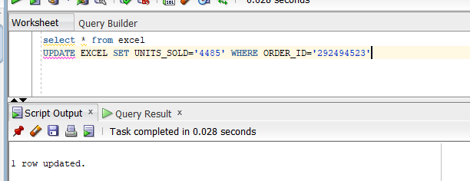
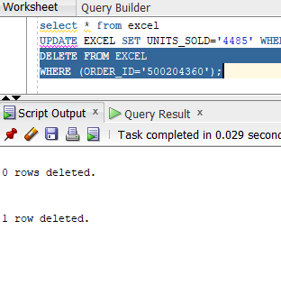
SQL UPDATE Statement:
UPDATE EXCEL SET UNITS_SOLD='4485' WHERE ORDER_ID='292494523'
SQL DELETE Statement:
DELETE FROM EXCEL
WHERE (ORDER_ID='500204360');

Slide 12
ALTER:
ALTER TABLE SALES ADD PRODUCT VARCHAR(50)

Slide 13
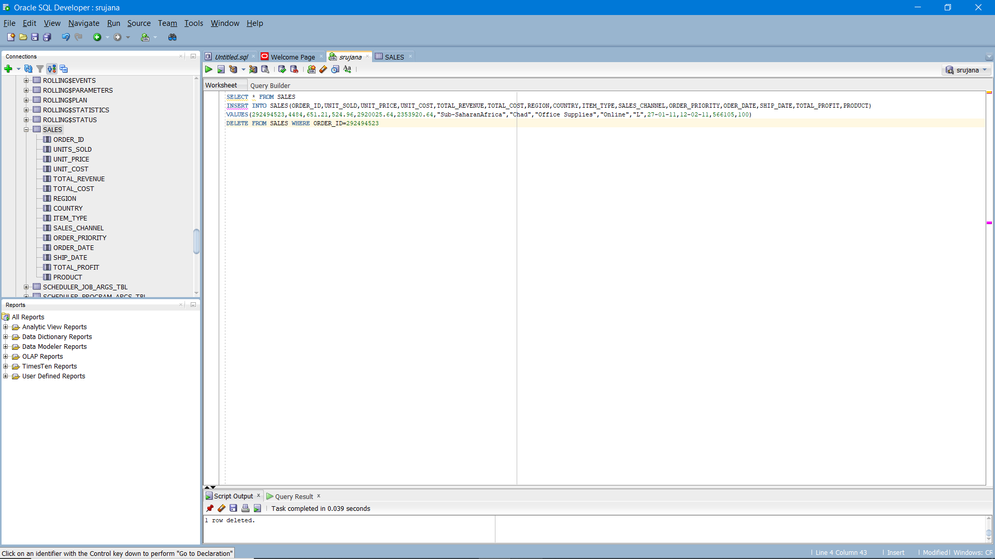
DELETE:
DELETE FROM SALES WHERE ORDER_ID=292494523

Slide 14
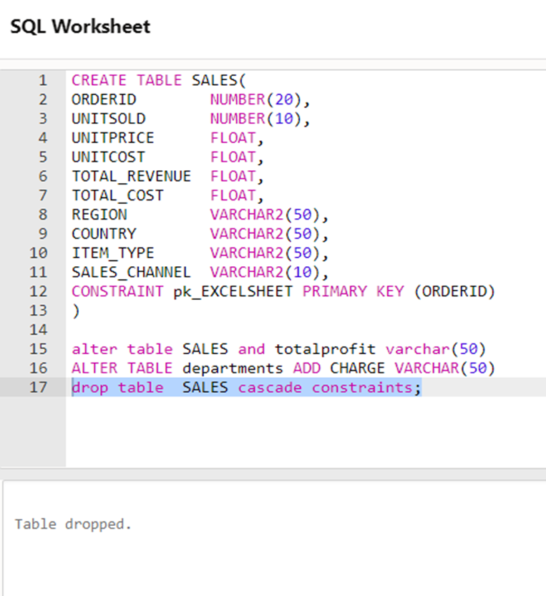
DROP:
Drop table SALES cascode constrainta;

Slide 15
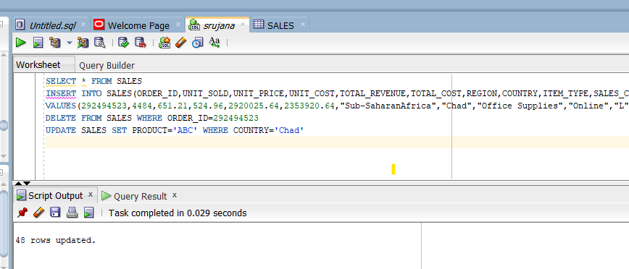
UPDATE:
UPDATE SALES SET PRODUCT='ABC' WHERE COUNTRY='Chad'

Slide 16
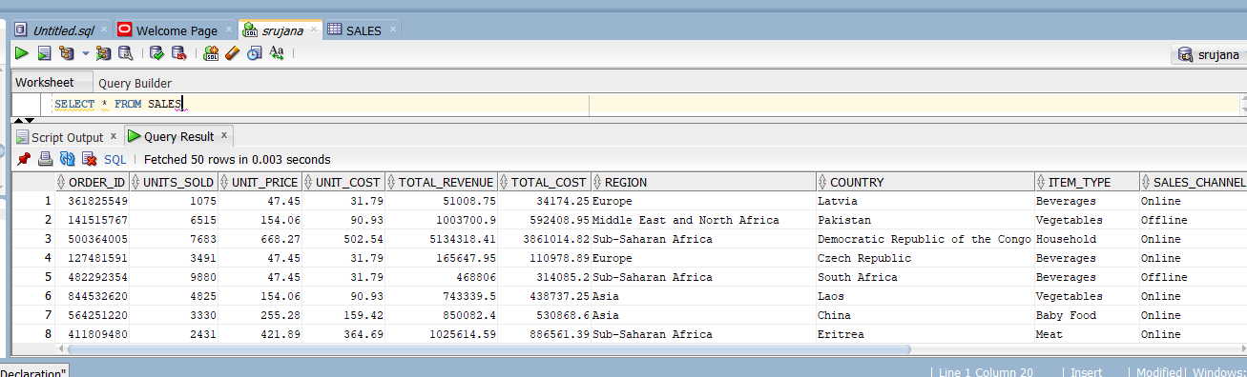
DQL - Data Query Language:
SELECT:

Slide 17
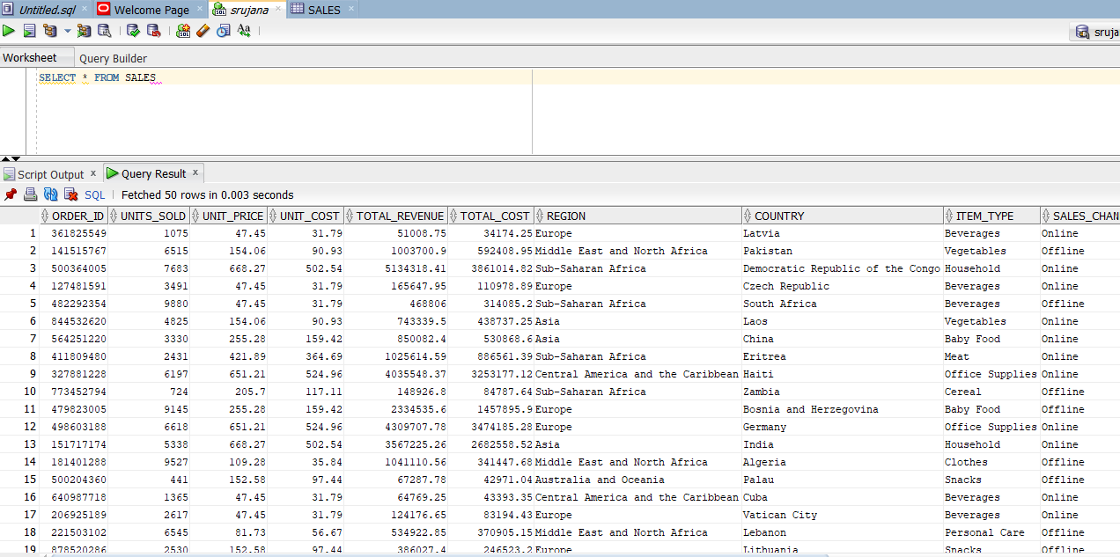
SELECT TABLE:
SELECT * FROM SALES

Slide 18
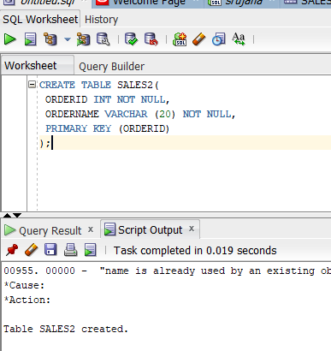
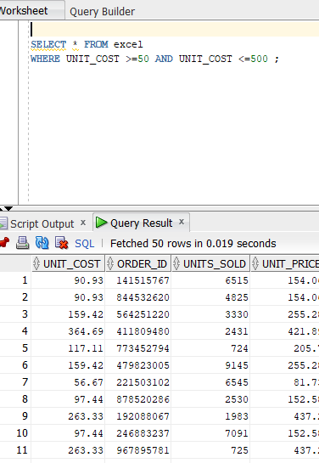
NOT NULL Constraint
SQL Comparison Operators:
FUNCTION QUERY:
SELECT * FROM excel
WHERE UNIT_COST >=50 AND UNIT_COST <=500 ;

Slide 19
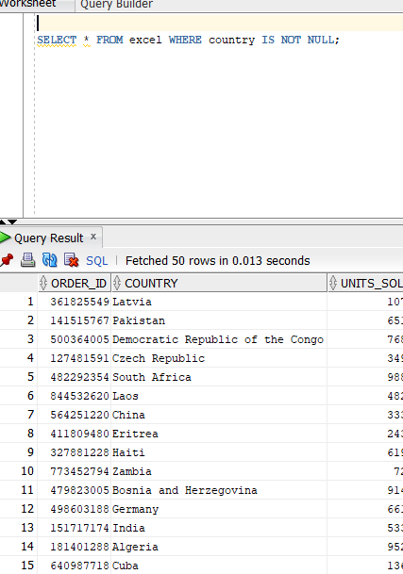
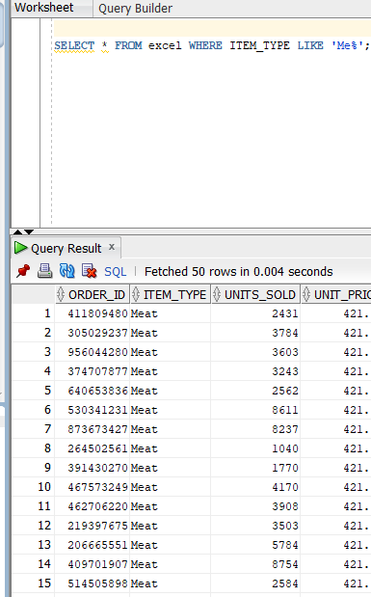
FUNCTION QUERY:
SELECT * FROM excel WHERE country IS NOT NULL;
FUNCTION QUERY:
SELECT * FROM excel WHERE ITEM_TYPE LIKE 'Me%';

Slide 20
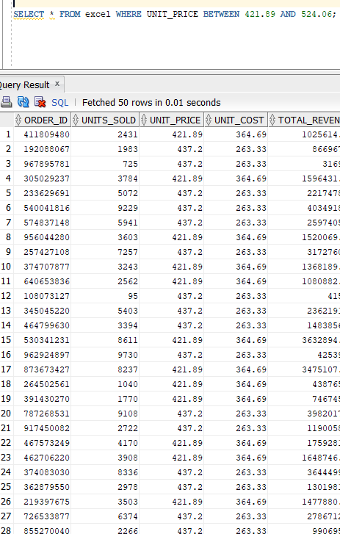
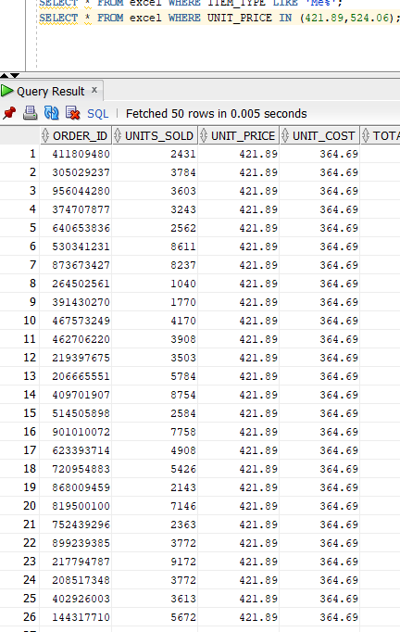
FUNCTION QUERY:
SELECT * FROM excel
WHERE UNIT_PRICE IN (421.89,524.06);
FUNCTION QUERY:
SELECT * FROM excel
WHERE UNIT_PRICE BETWEEN
421.89 AND 524.06;

Slide 21
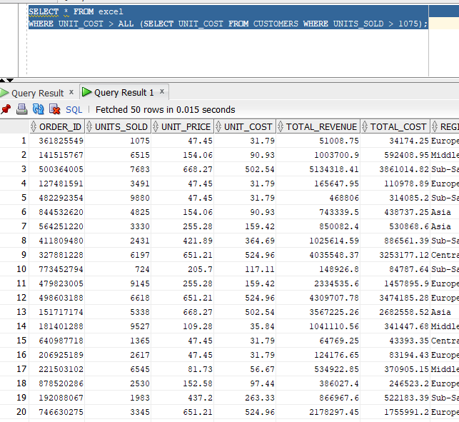
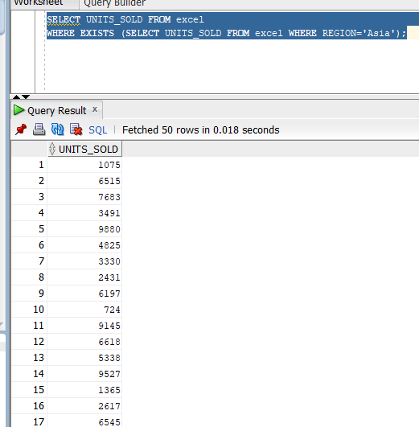
FUNCTION QUERY:
SELECT * FROM excel
WHERE UNIT_COST > ALL (SELECT UNIT_COST FROM CUSTOMERS WHERE UNITS_SOLD > 1075);
FUNCTION QUERY:
SELECT UNITS_SOLD FROM excel
WHERE EXISTS (SELECT UNITS_SOLD FROM excel WHERE REGION='Asia');

Slide 22
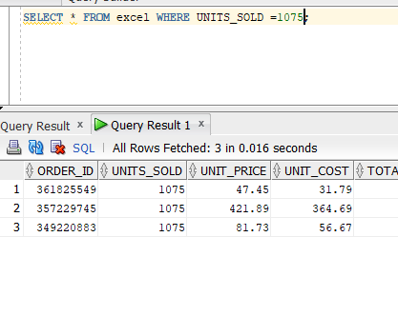
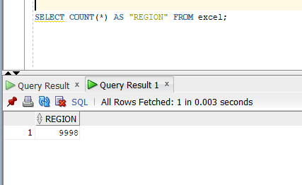
FUNCTION QUERY:
SELECT * FROM excel WHERE UNITS_SOLD =1075;
FUNCTION QUERY:
SELECT COUNT(*) AS "REGION" FROM excel;

Slide 23
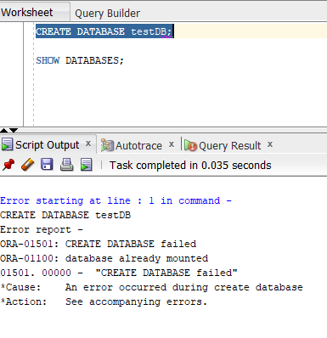
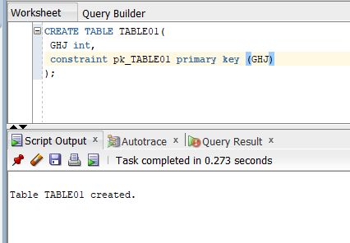
FUNCTION QUERY:
CREATE DATABASE testDB;
SHOW DATABASES;
FUNCTION QUERY:
CREATE TABLE TABLE01(
GHJ int,
constraint pk_TABLE01 primary key (GHJ)
);

Slide 24
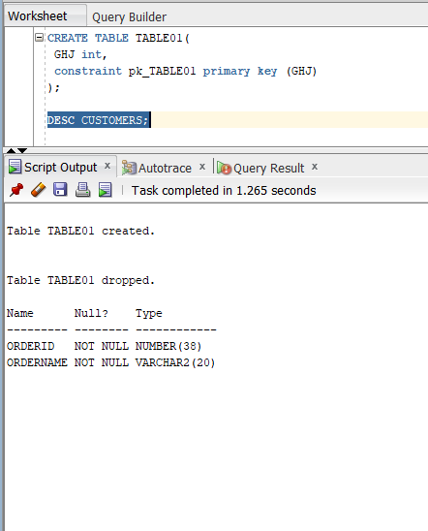
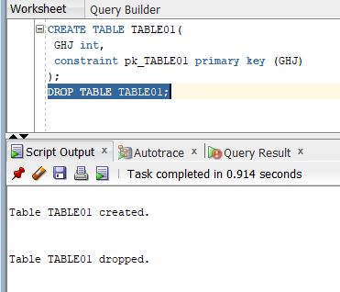
SQL DROP or DELETE Table
FUNCTION QUERY:
DESC CUSTOMERS;
FUNCTION QUERY:
DROP TABLE TABLE01;

Slide 25
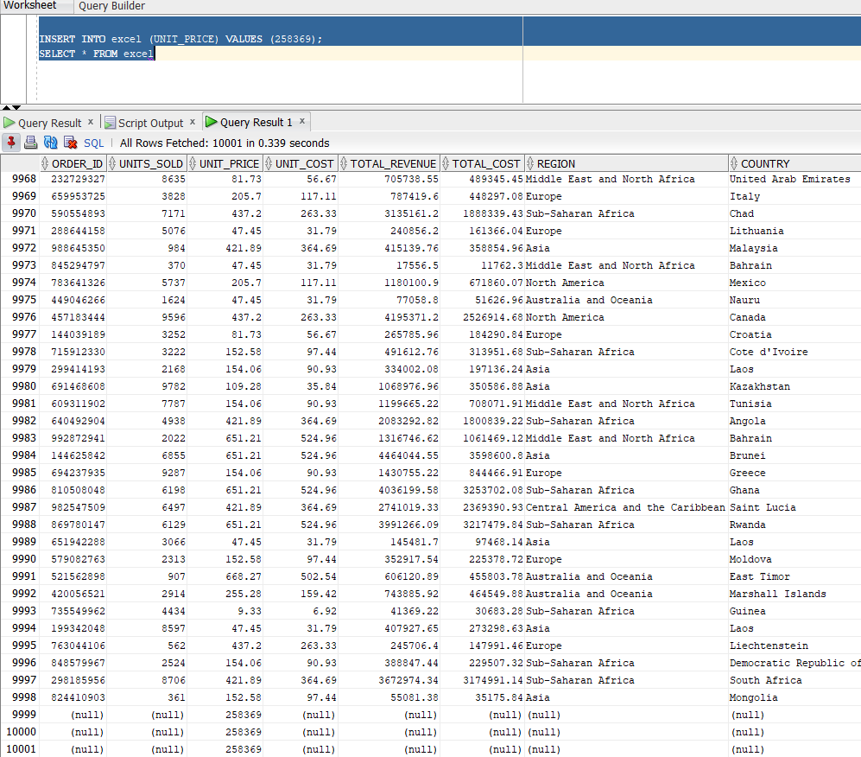
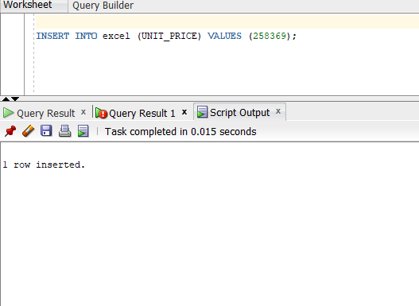
SQL INSERT Query
INSERT INTO excel (UNIT_PRICE) VALUES (258369);

Slide 26
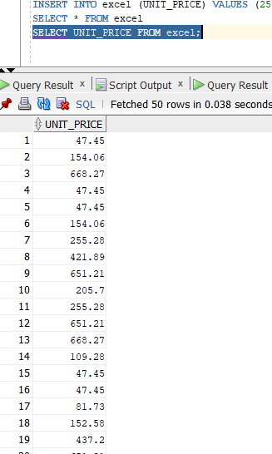
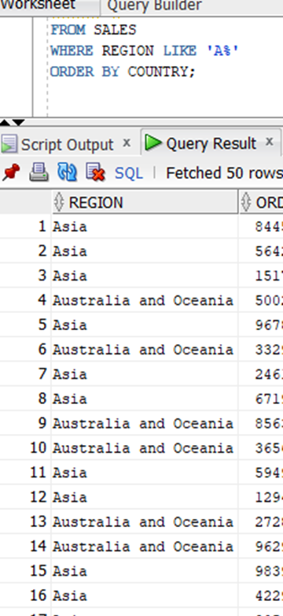
SQL SELECT Query
SQL WHERE Clause
FUNCTION QUERY :
SELECT UNIT_PRICE FROM excel;
SELECT *
FROM SALES
WHERE REGION LIKE 'A%'

Slide 27
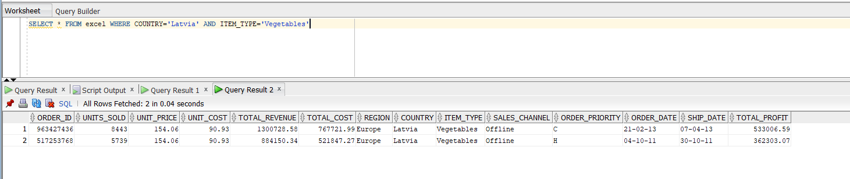
SQL AND and OR Operators
AND Operator:
SELECT * FROM excel WHERE COUNTRY='Latvia' AND ITEM_TYPE='Vegetables'

Slide 28
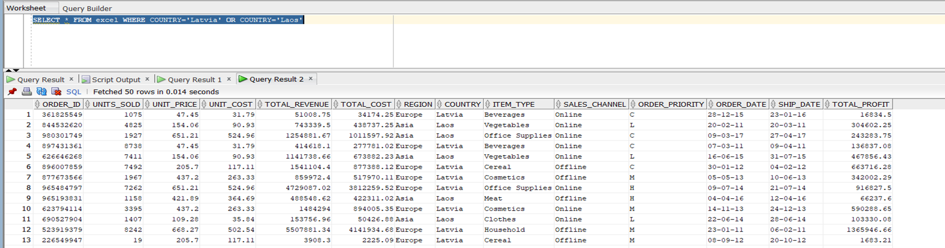
OR Operator:
SELECT * FROM excel WHERE COUNTRY='Latvia' OR COUNTRY='Laos'

Slide 29
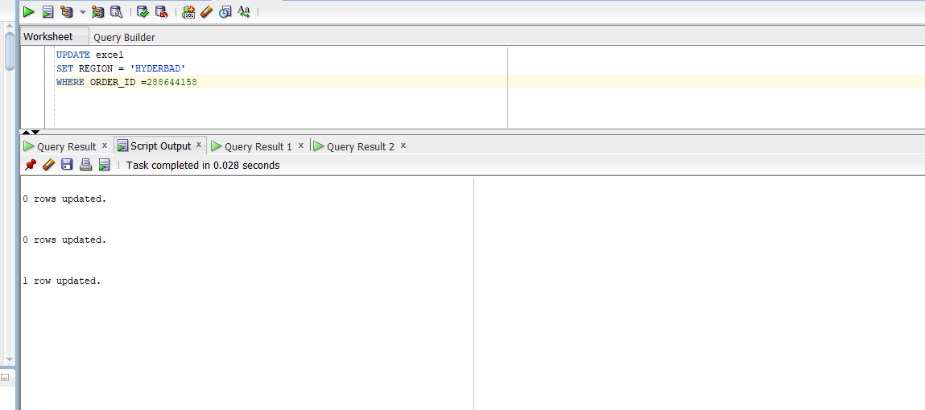
SQL UPDATE Query
UPDATE excel
SET REGION = 'HYD'
WHERE ORDER_ID =896007859 ;

Slide 30
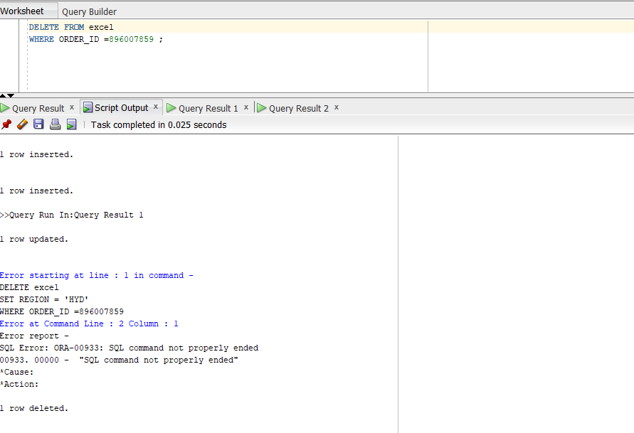
SQL DELETE Query:
DELETE FROM excel WHERE ORDER_ID=896007859

Slide 31
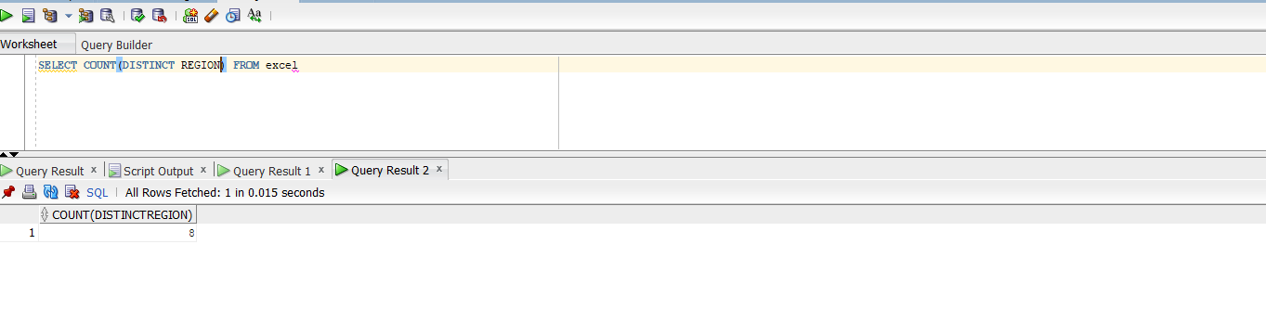
SQL LIKE Clause
SELECT COUNT(DISTINCT REGION) FROM excel

Slide 32
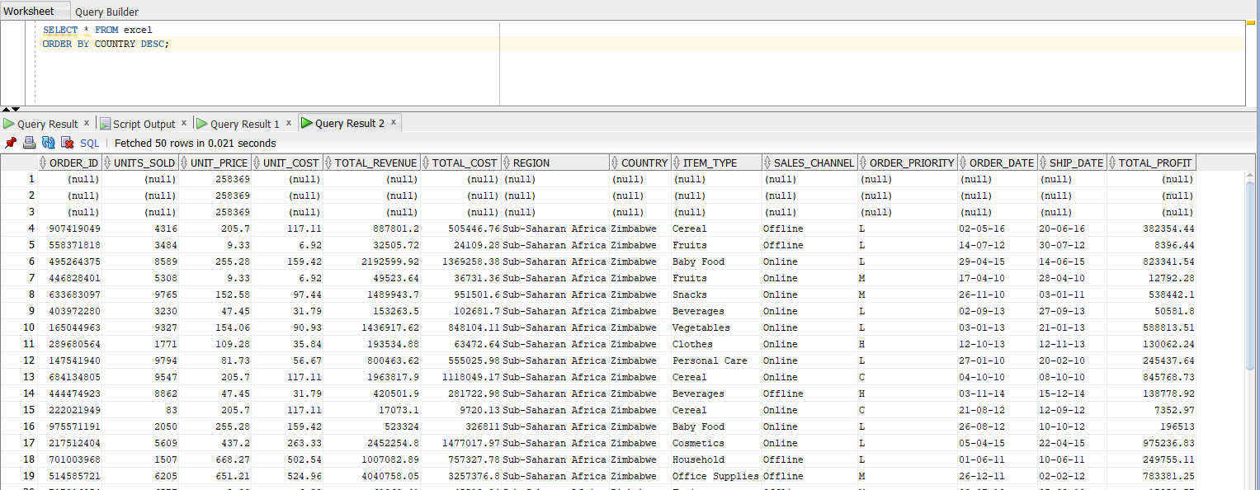
SQL SORTING Results
SELECT * FROM excel
ORDER BY COUNTRY DESC;

Slide 33
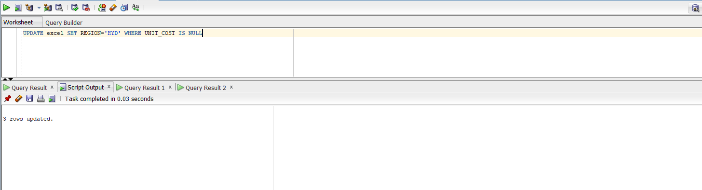
SQL Constraints
UPDATE excel SET REGION='HYD' WHERE UNIT_COST IS NULL

Slide 34

SQL GREATHER THAN (>):
select * from excel where TOTAL_REVENUE < 4000.0

Slide 35

SQL EQUAL TO (=):
SELECT * FROM excel where UNIT_COST='117.11'

Slide 36

SQL NOT EQUAL TO(!=)
SELECT * FROM excel WHERE UNITS_SOLD!=1075

Slide 37

SQL NOT EQUAL TO(<>):
SELECT * FROM excel WHERE UNITS_SOLD <> 1075

Slide 38

SQL GREATER THAN OR ERUAL TO (>=):
SELECT * FROM excel WHERE UNITS_SOLD >=1075

Slide 39
JOINS

Slide 40

INNER JOIN
SELECT * FROM SHEET1
INNER JOIN SHEET2 ON
SHEET1.ORDERID=SHEET2.ORDERIDS

Slide 41

LEFT JOIN
SELECT ORDERID,UNITSOLD,UNITPRICE,UNITCOST
FROM SHEET1
LEFT JOIN SHEET2 ONSHEET1.ORDERID=SHEET2.ORDERIDS

Slide 42

LEFT JOIN CLAUSE
SELECT * FROM SHEET1
LEFT JOIN SHEET2 ONSHEET1.ORDERID=SHEET2.ORDERIDS

Slide 43

RIGHT JOIN CLAUSE
SELECT *FROM SHEET1
RIGHT JOIN SHEET2 ONSHEET1.ORDERID=SHEET2.ORDERIDS

Slide 44

RIGHT JOIN
SELECT ORDERID,UNITSOLD,UNITPRICE,UNITCOST
FROM SHEET1
RIGHT JOIN SHEET2 ON SHEET1.ORDERID=SHEET2.ORDERIDS

Slide 45

FULL JOIN
SELECT * FROM SHEET1
FULL JOIN SHEET2 ONSHEET1.ORDERID=SHEET2.ORDERIDS

Slide 46

SELECT * FROM SHEET1
RIGHT JOIN SHEET2 ONSHEET1.ORDERID=SHEET2.ORDERIDS
UNION
SELECT * FROM SHEET1
LEFT JOIN SHEET2 ONSHEET1.ORDERID=SHEET2.ORDERIDS
UNION

Slide 47

SELF JOIN
SELECT UNITSOLD,UNITPRICE,UNITCOST,TOTAL_REVENUE,
TOTAL_COST
FROM SHEET1,SHEET2
WHERE
SHEET1.ORDERID < SHEET2.ORDERIDS

Slide 48

CARTESIAN JOINor CROSS JOIN
SELECT UNITSOLD,UNITPRICE,UNITCOST,TOTAL_REVENUE FROM SHEET1,SHEET2

Slide 49

UNION ALL Clause:
SELECT * FROM SHEET1
RIGHT JOIN SHEET2 ON SHEET1.ORDERID=SHEET2.ORDERIDS
UNION ALL
SELECT * FROM SHEET1
LEFT JOIN SHEET2 ON SHEET1.ORDERID=SHEET2.ORDERIDS

Slide 50

INTERSECT Clause
SELECT * FROM SHEET1
RIGHT JOIN SHEET2 ON SHEET1.ORDERID=SHEET2.ORDERIDS
INTERSECT
SELECT * FROM SHEET1
LEFT JOIN SHEET2 ON SHEET1.ORDERID=SHEET2.ORDERIDS

Slide 51

SQL NOT NULL Values
SELECT * FROM SHEET1 WHERE NAME IS NOT NULL;

Slide 52

SQL NULL Values
SELECT * FROM SHEET1 WHERE NAME IS NULL;

Slide 53


SQL ALTER TABLE Command
ALTER TABLE :
ALTER TABLE SHEET1 ADD AGE number;
ALTER TABLE SHEET1 DROP COLUMN AGE;
ALTER TABLE SHEET1 DROP COLUMN AGE;

Slide 54


TRUNCATE TABLE
TRUNCATE TABLE SHEET2;
Using Views
CREATE VIEW SHEET1_VIEW ASSELECT UNITSOLD,UNITPRICEFROM SHEET1;

Slide 55


Updating a View
UPDATE SHEET1
SET NAME='EFG’
WHERE ORDERID=361825549;
Deleting Rows into a View
DELETE FROM SHEET1
WHERE NAME='EFG';

Slide 56


COMMIT Command:
COMMIT;
ROLLBACK Command:
ROLLBACK;

Slide 57


Wildcard Operators
SELECT * FROM DEPARTMENTS WHERE name LIKE 'e%'
SELECT * FROM DEPARTMENTS WHERE NAME LIKE '%F_______'

Slide 58

SELECT * FROM departments
WHERE SALARY LIKE '9__2'

